Slide 1



Stock Market Data Analysis USING SPARK AND ML
Unlock the power of data analysis to navigate the dynamic stock market. Leverage Python and cutting-edge techniques to uncover insights, forecast trends, and optimize investment strategies.
by Shalini Galingula
SE23MAID005

Slide 2
Introduction
The stock market is a complex and ever-changing landscape. By analyzing historical data, we can gain valuable insights to inform investment decisions and develop robust trading strategies.
STOCK MARKET MANAGEMENT NEEDS A BIG DATA ANALYTICS AS THE DATA IS BIG BY VELOCITY,VARIETY,VOLUME AND THE DATA IS CONTINOUS STREAMING DATA WHICH NEEDS MANAGEMENT AND BETTER PREDICTION.

Slide 3
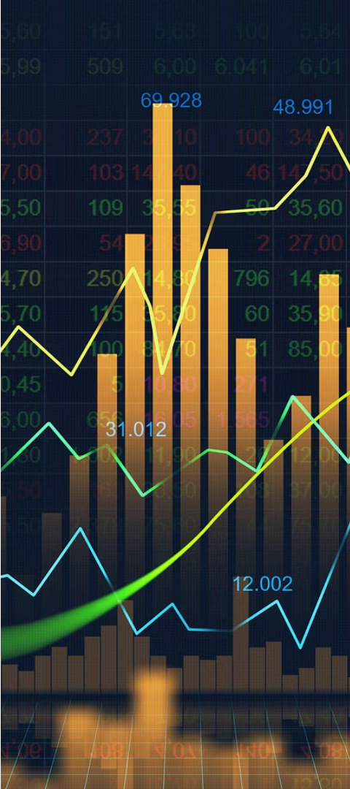
Data Acquisition
1
Tickers
2
Date Range
AAPL, GOOGL, MSFT
2015-01-01 to 2023-04-30
3
Source
Yahoo Finance (yfinance)

Slide 4
Data Cleaning and Preprocessing
Handling Missing Data
Feature Engineering
Normalization
Create new derived features that can provide additional insights.
Ensure data is on a common scale to enable effective analysis.
Identify and address any gaps or inconsistencies in the dataset.

Slide 5
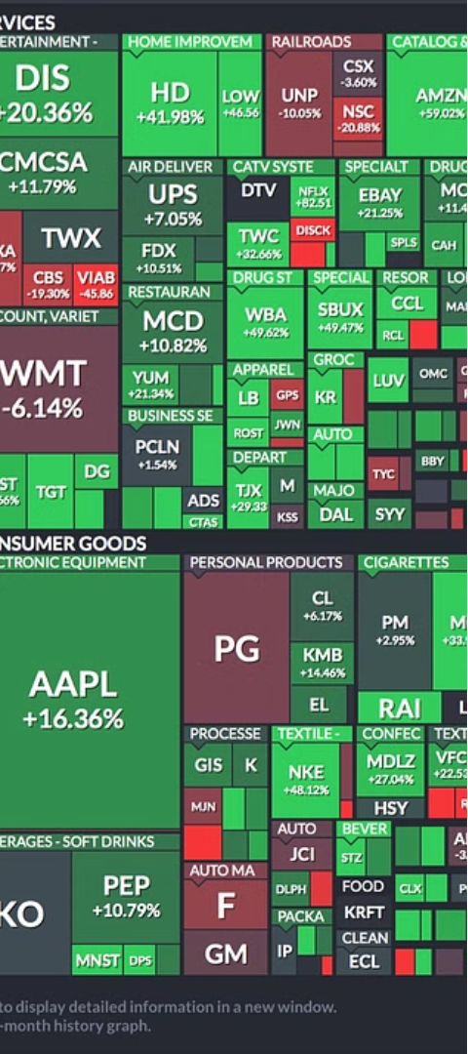
Exploratory Data Analysis
1
Trend Analysis
Identify long-term patterns and movements in the stock prices.
2
Correlation
Examine the relationships between different stocks and market indicators.
3
Volatility
Assess the degree of price fluctuations and risk associated with each stock.

Slide 6
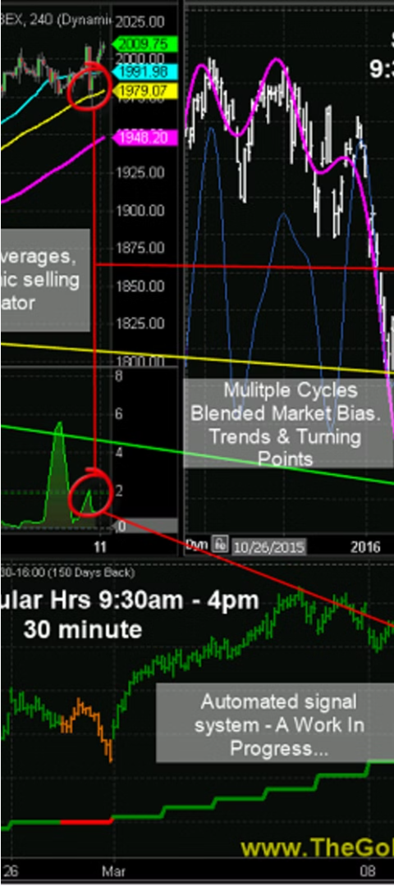



Stock Price Forecasting
Time Series Analysis
Leverage historical data to model and predict future stock prices.
Machine Learning
Develop advanced algorithms to identify patterns and trends for accurate forecasting.
Evaluation
Assess the accuracy and reliability of the forecasting models.

Slide 7



Portfolio Optimization
Diversification
Risk Management
Return Maximization
Reduce risk by investing in a variety of assets.
Implement strategies to mitigate potential losses.
Optimize the portfolio for maximum returns within risk constraints.

Slide 8
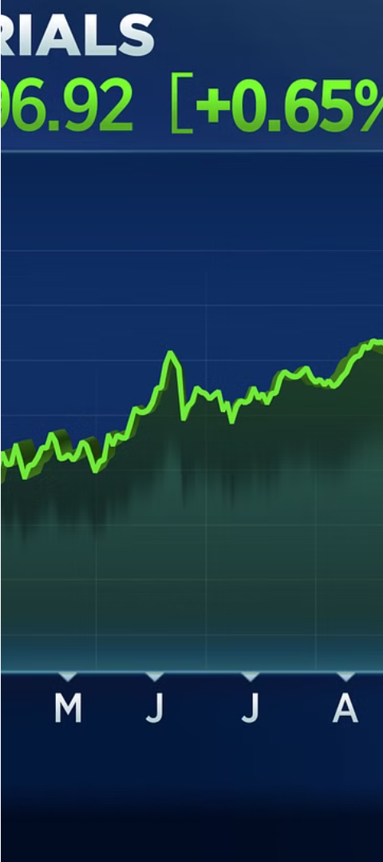
Conclusion and Key Takeaways
Data-Driven Insights
Informed Decision-Making
Leveraging data analysis can provide valuable insights to navigate the complex stock market.
Combining quantitative analysis with market understanding leads to more confident investment decisions.
Continuous Improvement
Regularly reviewing and refining the analysis process is crucial for staying ahead of market trends.

Slide 9
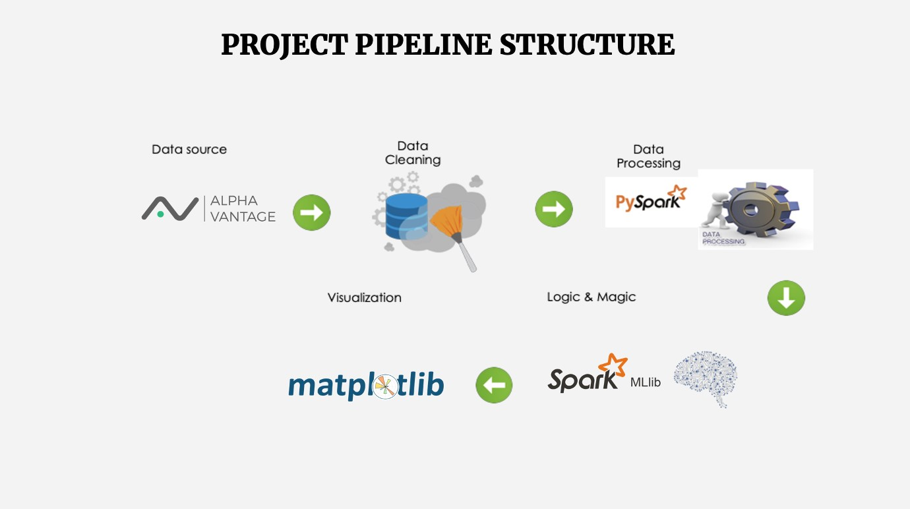

Slide 10
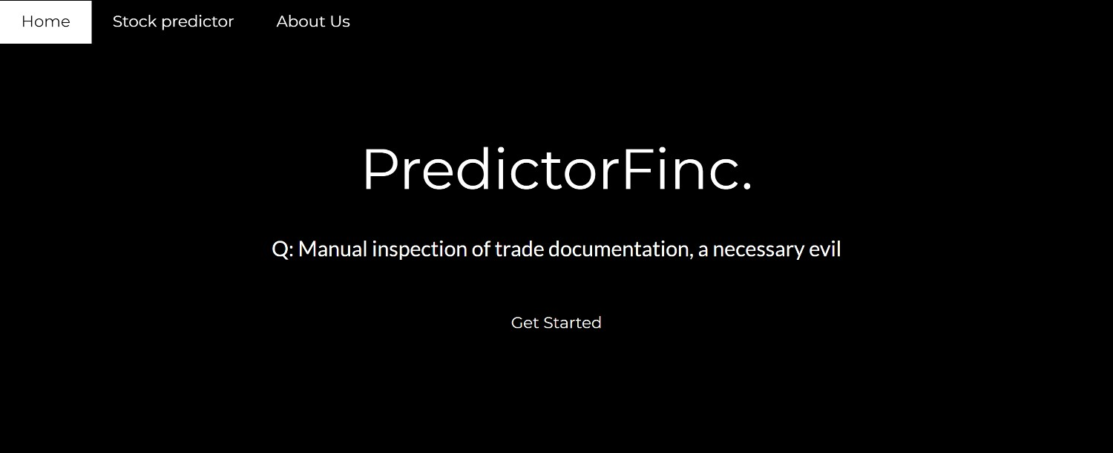

Slide 11
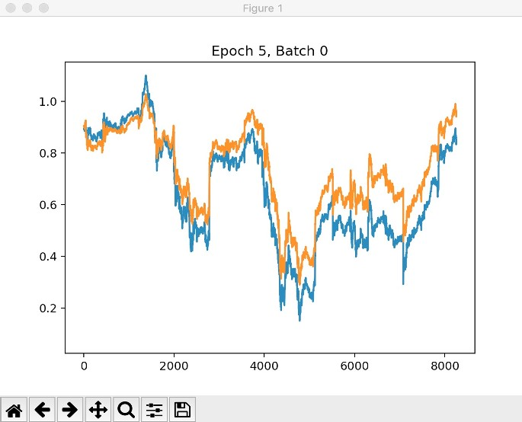

Slide 12
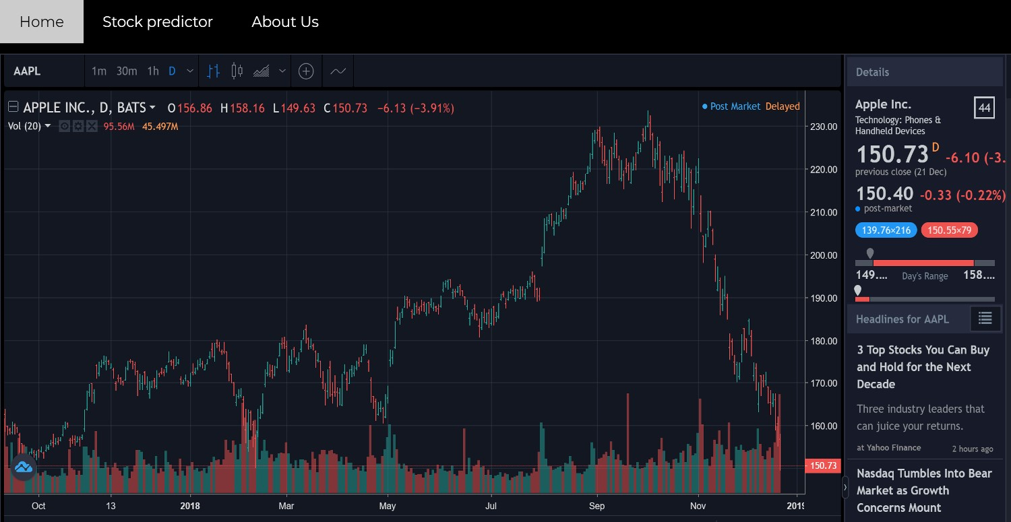

Slide 13
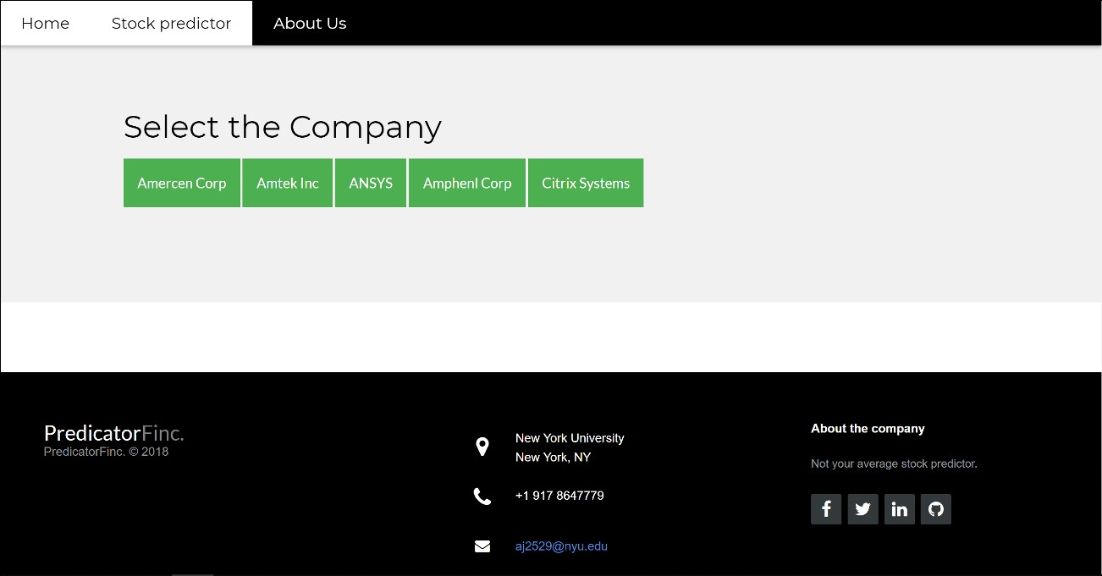

Slide 14
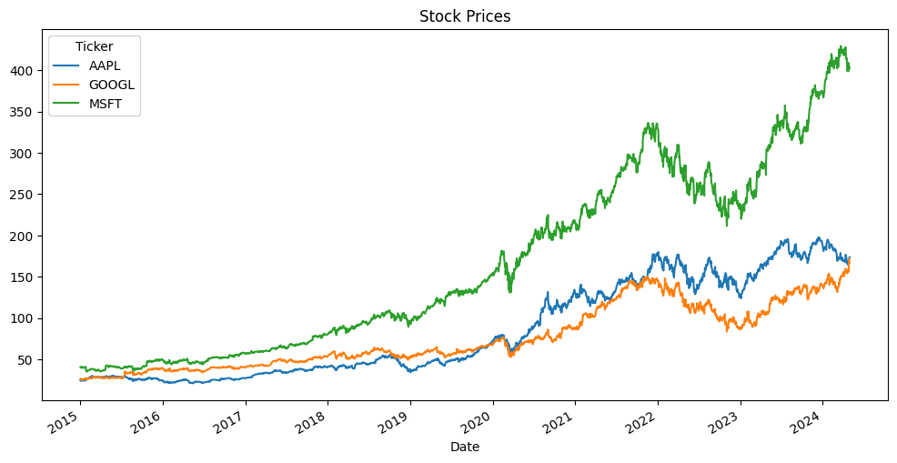
This is output of stock price prediction by the code :

Slide 15
THANK YOU!

